Slide 1

Microsoft AL
GUI & In-Client Designer III

Slide 2



Prerequisite
Use Workshop-VM / Workshop-Computer follow the instructions of the Boarding Pass
Visual Studio Code
https://code.visualstudio.com
Competence Team DevTech
Microsoft AL

Slide 3
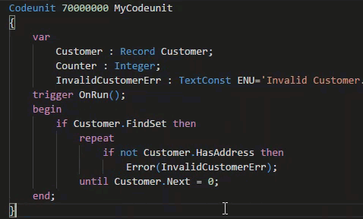
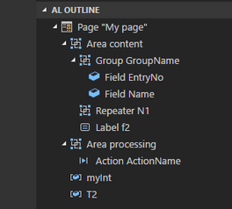
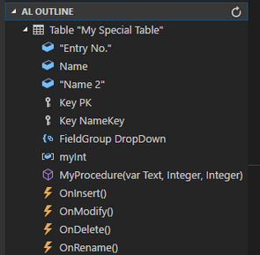
VS Code Useful Extensions
AL Formatter
Indentation
Keyword case style
Sort variable definitions
Readability Guidelines - Spacing and newlines (experimental)
AL Code Outline
Outlining – AL Object Structure
“Create List Page” from Table
“Create Card Page” from Table
al-util
“Rename & Move” Objects
Templates e.g. “Readme.md”

Slide 4
GUI & In-Client Designer Agenda
1
Language & Types (Re-Cap)
2
Notification
3
Wizard Basics
4
Hands On

Slide 5

Microsoft AL
Language & Types
Re-Cap

Slide 6
Microsoft AL Language & Types
Recommendation for VS Code
1 File per Object
Organize Object Files in Folders (Pages, PageExtension, …)
Use Snippets in AL
ttable
tpageext
tcodeunit
…
Documentation - Development in AL
https://docs.microsoft.com/.../developer/devenv-dev-overview
C/Side | Microsoft AL
 | Extending | New
Codeunit | - | codeunit
Table | tableextension | table
Page | pageextension pagecustomization | page
XMLport | - | xmlport
Query | - | query
Report | - | report
Menu Suite | - | -
 |  | profile
 |  | controladdin

Slide 7

Improve the UX
Features
Notification
Wizard Basics

Slide 8
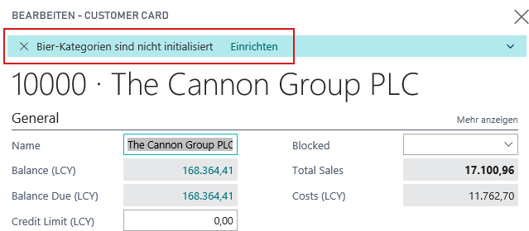
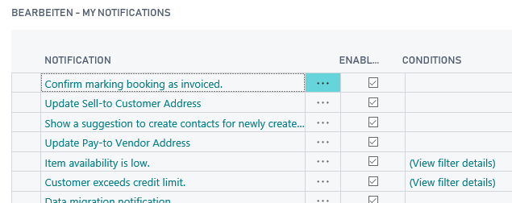
Pages in Microsoft AL Improve the UX
Notifictation “… programmatic way to send non-intrusive information to the User Interface (UI)…”
ID Guid
Message
Scope Local / Global
Actions
GetData(…) / SetData(…)
Configurable
Record "My Notifications“ → IsEnabled(…) / IsEnabledForRecrod(…)

Slide 9
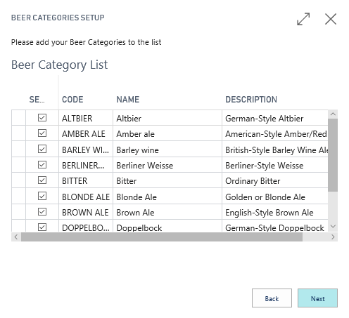
Pages in Microsoft AL Improve the UX
Wizards
Object Type Page (Navigation)
Groups InstructionalText
Actions
Back, Next, Finish Visibility depends on Page
Properties InFooterBar
Groups = Wizard Pages Show / Hide for each Page
Start Page / Welcome Introduktion
Page XYZ
Finish Page Summary

Slide 10
It’s Lab Time
Hands On
Notification
Wizard (Skeleton)

Slide 11
Pages in Microsoft AL Hands On
Material
Project Skeleton „02-GUI-&-In-Client-Designer\Starter\03 My Favorite Beer\”
Tables: “Beer Category”
Tables.Extensions: “Customer”, “Item”
Pages: “Beer Category Card [CC]”, “Beer Category List [CC]”
Pages.Extensions: “Item Card”, “Customer Card”
Prerequisites
Connect to your Workshop VM → use Instructions on your Workshop Boarding Pass
Hand On - Tasks
Invoke a Notification, when the selected Beer does not match the Customers Favorite Beer Category
Create a Setup Wizard skeleton to initialize Beer Categories and use a List Part for Table “Beer Category”
Invoke a Notification, when Beer Categories are empty and start the Wizard by a Notification Action

Slide 12
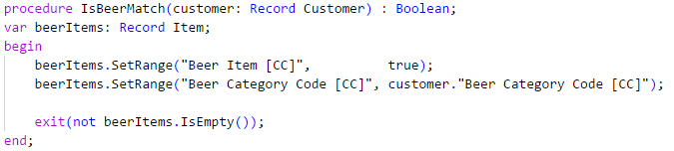
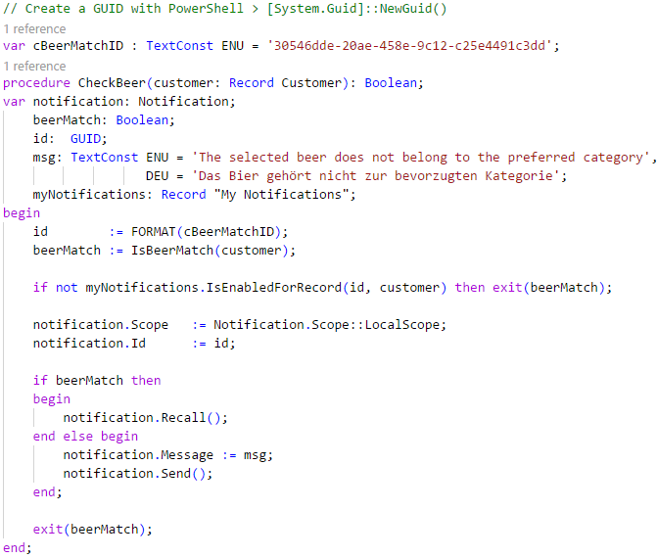
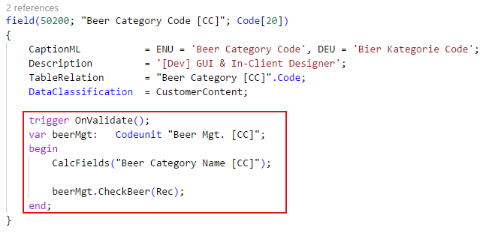
Pages in Microsoft AL Hands On – Notification
Create a Code Unit „Beer Mgt. [CC]“ ID: 50201
Add 2 Methods
IsBeerMatch … check the correctness of the beer
CheckBeer … use the check and show a notification
Use the codeunit from table extension “Customer [CC]” to check and invoke a notification

Slide 13
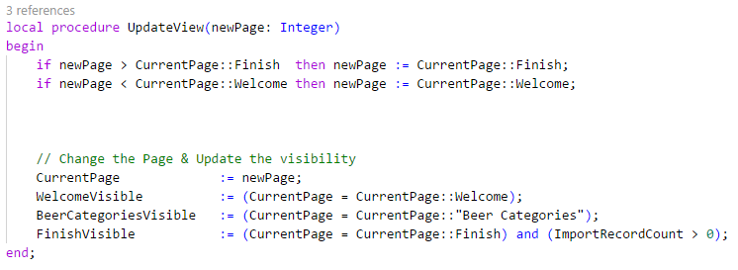
Pages in Microsoft AL Hands On – Wizard
Create a Page „Beer Wizard [CC]“ ID: 50200
Add 1 Variable (Option) CurrentPage "Welcome", "Beer Categories", "Finish"
Add 3 Variables (Boolean) WelcomeVisible, BeerCategoriesVisible, FinishVisible
Add 3 Pages (Groups) "Welcome", "Beer Categories", "Finish" Caption, InstructionalText, Visible …
Add 3 Actions Back, Next, Finish
Manage the visible Page by this method and check the result

Slide 14
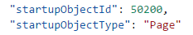
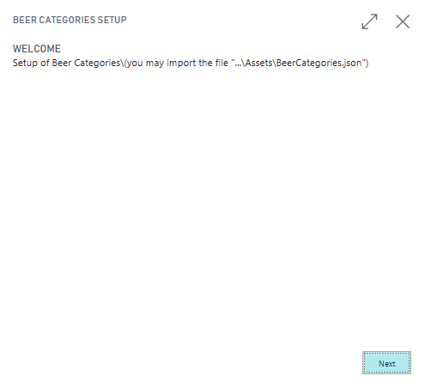
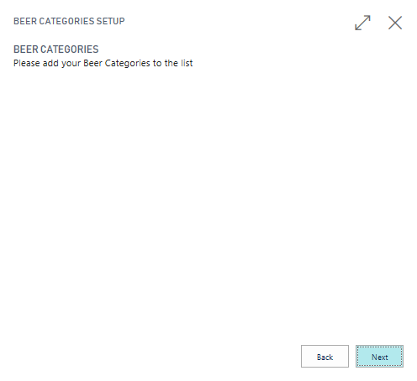
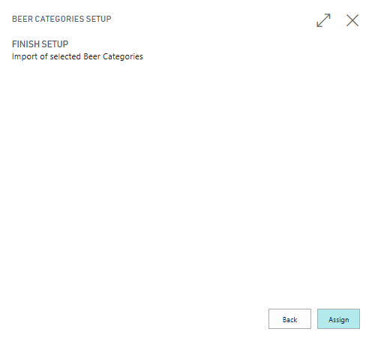
Pages in Microsoft AL Hands On – Wizard
Call the Wizard by changing the “launch.json” StartupObject information
The Wizard skeleton should look like this:

Slide 15
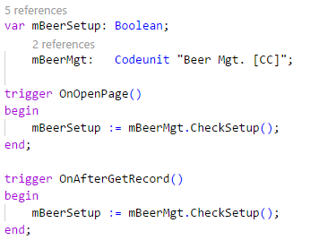
Pages in Microsoft AL Hands On – Notification & Assisted Setup
Use Code Unit „Beer Mgt. [CC]“ ID: 50201
Add some Methods to achieve this task: “Show a notification, when the record “Beer Categories” is empty and call the “Beer Wizard” from the notification by using an action”
Methods can be
IsBeerSetupComplete … check if record “Beer Categories” is empty
CheckBeerSetup … use the check and show a notification
StartBeerSetup … callback method for the notification action
Use the codeunit from “Customer Card [CC]” and invoke a notification

Slide 16

Q & A
Visual Studio Code
https://code.visualstudio.com
Competence Team DevTech
Channel Microsoft AL

